Slide 1


Minor Project: Synopsis Presentation
Title:
Edu Scan: Bridging Gaps in Villages
Presented by:
Anushk Sanghvi, R2142210134, CSE DevOps (Hons.)
Chitranshu Sharma, R2142210249, CSE DevOps(Non Hons.)
Devesh Singh, R2142210268, CSE DevOps(Non Hons.)
Raghav Mittal, R2142210616, CSE DevOps(Non Hons.)
Guided by:
Dr Arjun Arora
Assistant Professor-(SS)
Cybernetics Cluster
School of Computer Science

Slide 2
Contents: -
Introduction
Motivation
Objective
Problem Statement
Tech Stack
Methodology
Application of the Project
Data Flow Diagram (DFD)
PERT Chart
References
Survey

Slide 3
Introduction:-
Addressing Educational Disparities
Platform Development
Technological Approach
Target Audience
Structured Content
Skill Development
Engaging Learning Experience.
Interactive Features.
Deployment Strategy
Notes:
Addressing Educational Disparities: Recognizing the gap in educational opportunities in rural villages, particularly for students struggling to grasp concepts due to various challenges.
Platform Development: Creating a sustainable platform through a QR-based website accessible to rural village students, regardless of their geographical location or socio-economic background.
Technological Approach: Utilizing HTML, CSS for frontend development, and Node.js for backend, ensuring a user-friendly interface and smooth functionality.
Target Audience: Focusing on students in grades 1 to 5, catering to their specific educational needs and levels of understanding.
Structured Content: Organizing the website into different sections for each class, providing tailored educational materials and resources for effective learning.
Skill Development: Offering additional content on general knowledge and communication skills, enhancing the holistic development of students beyond academic subjects.
Engaging Learning Experience: Incorporating animated or cartoon-style content to make learning enjoyable and engaging for students.
Interactive Features: Including quizzes, question banks, and interactive activities to reinforce learning and encourage active participation.
Deployment Strategy: Utilizing DevOps tools such as Terraform, Ansible, and Kubernetes for efficient deployment and orchestration of the website.

Slide 4
2. Motivation: -
Addressing Educational Disparities
Equal Opportunity for Every Child
Empowerment through Education
Inspiration from Successful Initiatives
Creating a Sustainable Model
Notes:
1. Addressing Educational Disparities: The project aims to tackle the persistent educational disparities prevalent in rural villages worldwide. These communities face various challenges such as inadequate infrastructure, shortage of qualified teachers, socio-economic barriers, and lack of technological resources, all of which hinder access to quality education.
2. Equal Opportunity for Every Child: The motivation behind the project stems from the belief that every child, regardless of their location or socio-economic background, deserves access to quality education. It seeks to level the playing field and provide equal opportunities for personal and socio-economic growth to all children in rural villages.
3. Empowerment through Education: By bridging the educational gaps, the project aims to empower individuals within rural villages. Access to quality education not only enhances knowledge and skills but also opens doors to better opportunities, thereby empowering individuals to improve their lives and communities.
4. Inspiration from Successful Initiatives: The project draws inspiration from successful educational interventions documented in literature, such as the Digital Study Hall project in India and the Bridge Academy model in Africa. These initiatives highlight the transformative impact of technology and community engagement in improving educational outcomes in underserved areas.
5. Creating a Sustainable Model: Overall, the motivation is to create a sustainable model for educational empowerment in rural villages. By fostering a culture of continuous learning, leveraging technology, and engaging with the community, the project aims to contribute to individual and community development in the long term.

Slide 5
3. Objective: -
Expanding Access to Quality Education.
Fostering Community Engagement and Empowerment.
Enhancing Educational Outcomes.
Deploying our website using DevOps Tools.
Notes:
Expanding Access to Quality Education:
Address barriers like inadequate infrastructure and financial constraints.
Ensure all individuals have the opportunity for a high-quality education.
Improve infrastructure and offer scholarships and financial aid.
Leverage technology for remote learning.
2. Fostering Community Engagement and Empowerment:
Build partnerships with local communities and organizations.
Involve parents, guardians, and community leaders in decision-making.
Offer adult education and vocational training programs.
Empower communities to take ownership of educational institutions.
3. Enhancing Educational Outcomes:
Implement evidence-based teaching methods.
Provide professional development opportunities for educators.
Offer personalized learning experiences.
Continuously improve teaching practices and monitor student progress.
Create a positive and supportive learning environment.

Slide 6
4. Problem Statement: -
Limited Access to Quality Infrastructure
Shortage of Qualified Teachers
Socioeconomic Barriers
Lack of Technological Resources
Limited Curriculum and Extracurricular Activities
Health and Nutrition Challenges
Cultural and Linguistic Diversity
Geographical Isolation
Notes:
Limited Access to Quality Infrastructure:
Rural villages often lack proper school buildings, classrooms, libraries, and other educational facilities.
Infrastructure deficiencies hinder the learning environment and overall quality of education.
Shortage of Qualified Teachers:
Rural areas struggle to attract and retain qualified teachers due to lower salaries, limited professional development opportunities, and isolation from urban centers.
The shortage leads to larger class sizes, less individualized attention, and lower educational outcomes.
Socioeconomic Barriers:
Poverty and economic hardship in rural communities can prevent families from affording school supplies, uniforms, and transportation costs.
Socioeconomic factors also contribute to higher dropout rates as children may need to work to support their families.
Lack of Technological Resources:
Many rural schools lack access to computers, internet connectivity, and educational technology.
The digital divide further widens the gap between rural and urban educational opportunities.
Limited Curriculum and Extracurricular Activities:
Rural schools may offer a limited range of courses and extracurricular activities due to resource constraints.
This limitation can impede students' ability to explore diverse interests and develop essential skills beyond academics.
Health and Nutrition Challenges:
Poor access to healthcare and nutrition services can impact students ability to learn and attend school regularly.
Malnutrition, illness, and lack of sanitation facilities can all affect educational outcomes.
Cultural and Linguistic Diversity:
Rural communities often have diverse cultural and linguistic backgrounds, which may not be adequately represented in the curriculum or teaching staff.
Language barriers can hinder effective communication and learning in schools.
Geographical Isolation:
Remote rural locations can make it difficult for students to access educational resources, extracurricular activities, and academic support services.
Geographic isolation also affects teacher recruitment and professional development opportunities.

Slide 7
5. Technology Stack: -
Front-End Development: HTML, CSS, JavaScript
Back-End Development: Node.js for server-side logic
Database: NoSQL Data Base- MongoDB for Data Base storage
Version Control: Git and GitHub for code versioning and collaboration
Hosting and Deployment: Vercel or AWS
DevOps Tools: Terraform, Ansible, Jenkins, Docker, Git
Development Environment: Integrated Development Environments (IDEs) such as Visual Studio Code or PyCharm
Animating the Content: Blender

Slide 8
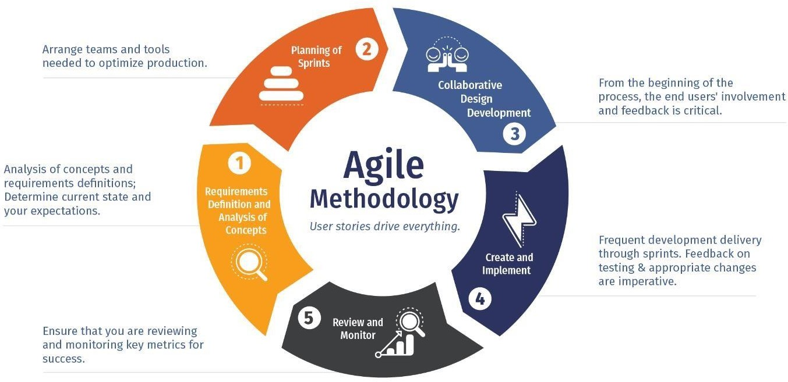
6. Methodology: -
Iterative Approach
Flexibility and Collaboration
Customer Feedback
Sprints
Continuous Improvement
Adaptability
Empirical Process Control
Cross-Functional Teams
Notes:
Agile methodology is an iterative approach to software development and project management that emphasizes flexibility, collaboration, and customer feedback.
The project is broken down into small, manageable chunks called iterations or sprints. Each sprint typically lasts for a few weeks and results in a potentially shippable product increment.
Agile allows for changes to be incorporated throughout the development process which makes our project more flexible and adaptable.
Agile promotes continuous improvement through regular reflection and adaptation. At the end of each sprint, the team conducts a retrospective to identify what went well, what could be improved, and any adjustments needed for future sprints. This allows the team to respond to lessons learned and refine their approach over time.

Slide 9
7. Application of the Project: -
Access to Quality Education
Personalized Learning
Community Engagement and Empowerment
Professional Development for Educators
Continuous Improvement
Notes:
1. Access to Quality Education: The primary application of the project is to provide rural village students with access to quality education through a digital platform. By leveraging technology, such as the website and QR-based resources, students can access educational materials, tutorials, and quizzes tailored to their needs. This application helps bridge the gap in educational opportunities between rural and urban areas.
2. Personalized Learning: The project aims to offer personalized learning experiences for students in rural villages. Through the website and interactive content, students can learn at their own pace and according to their individual learning styles. This application ensures that education is more inclusive and effective, catering to the diverse needs of students.
3. Community Engagement and Empowerment: Another application of the project is community engagement and empowerment. By involving parents, guardians, community leaders, and local organizations in the educational process, the project fosters a sense of ownership and collaboration within the community. This application strengthens the support system for students and contributes to the sustainability of educational initiatives in rural villages.
4. Professional Development for Educators: The project also includes professional development opportunities for educators in rural areas. By providing training and resources, educators can enhance their teaching skills and adopt innovative teaching methods. This application improves the quality of instruction and contributes to better educational outcomes for students.
5. Continuous Improvement: Through the Agile methodology adopted in the project's development process, there is a focus on continuous improvement. This application ensures that the project evolves over time based on feedback and lessons learned. Regular reflection and adaptation allow the project team to refine their approach and make necessary adjustments to meet the needs of rural village students effectively.

Slide 10
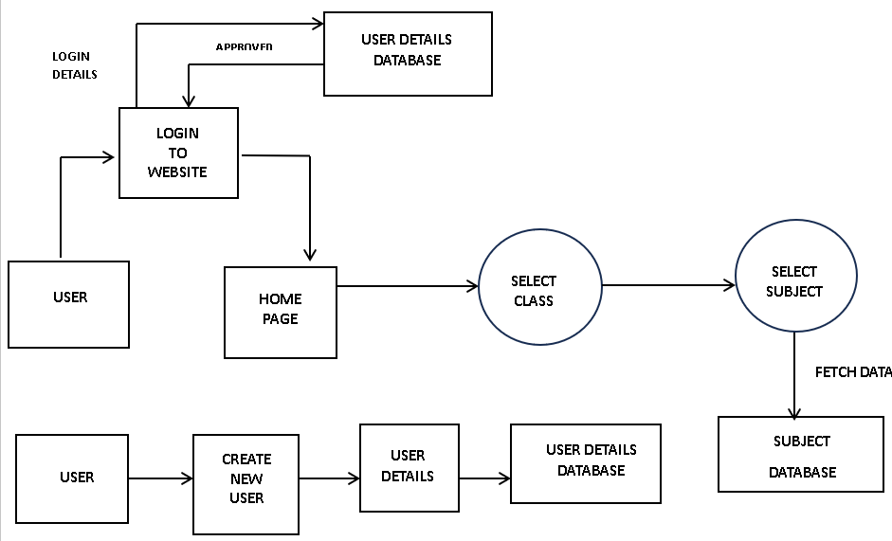
8. Data Flow Diagram:

Slide 11
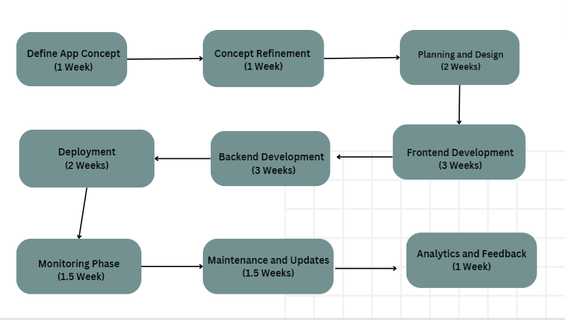
9. PERT Chart: -
Figure Program Evaluation Review Technique Chart

Slide 12
10. References: -
Abhijit, B., & Rukmini, B. (2018). Digital Study Hall: An Innovative Education Model for Rural India. Journal of Educational Technology, 15(2), 45-58.
Bruns, B., Filmer, D., & Patrinos, H. A. (2018). Making Schools Work: New Evidence on Accountability Reforms. The World Bank.
Davis, N. E., & Pearce, J. (2019). Scaling up Mobile Learning: Leveraging Community Networks. Journal of Interactive Media in Education, 1(2), 34-47

Slide 13
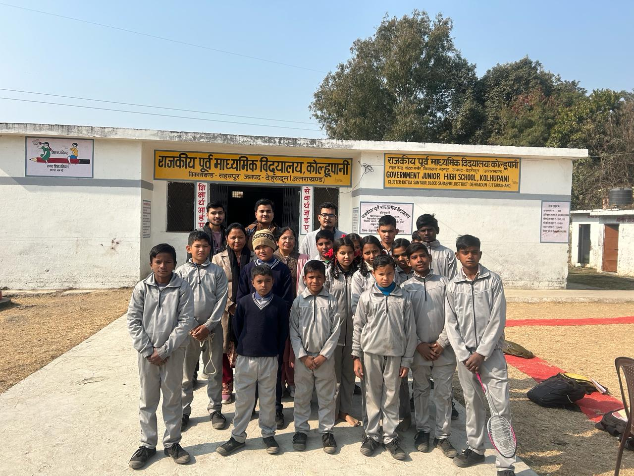
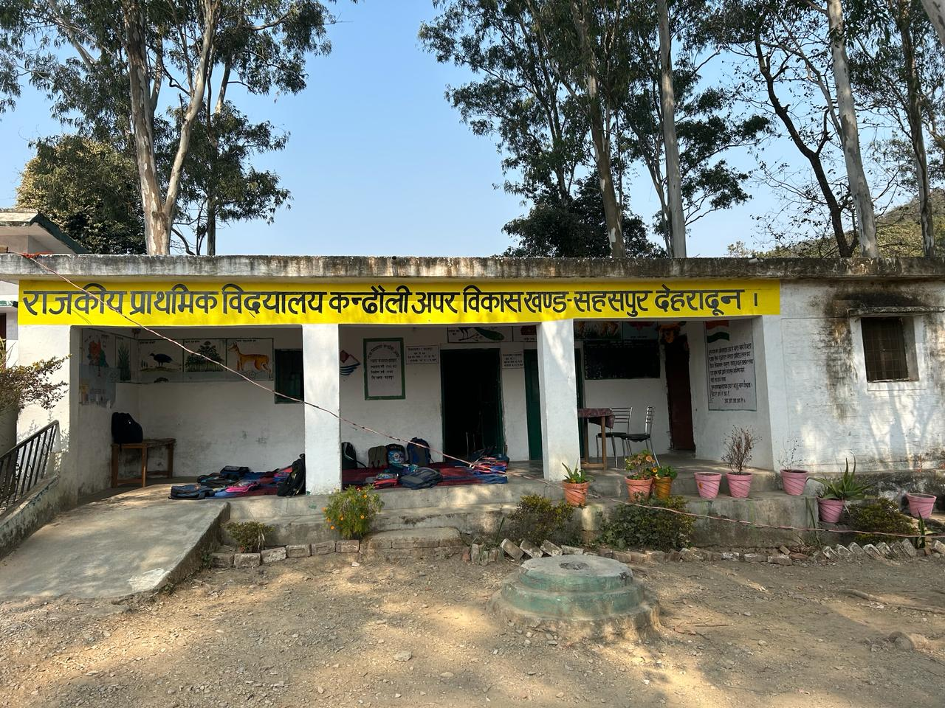
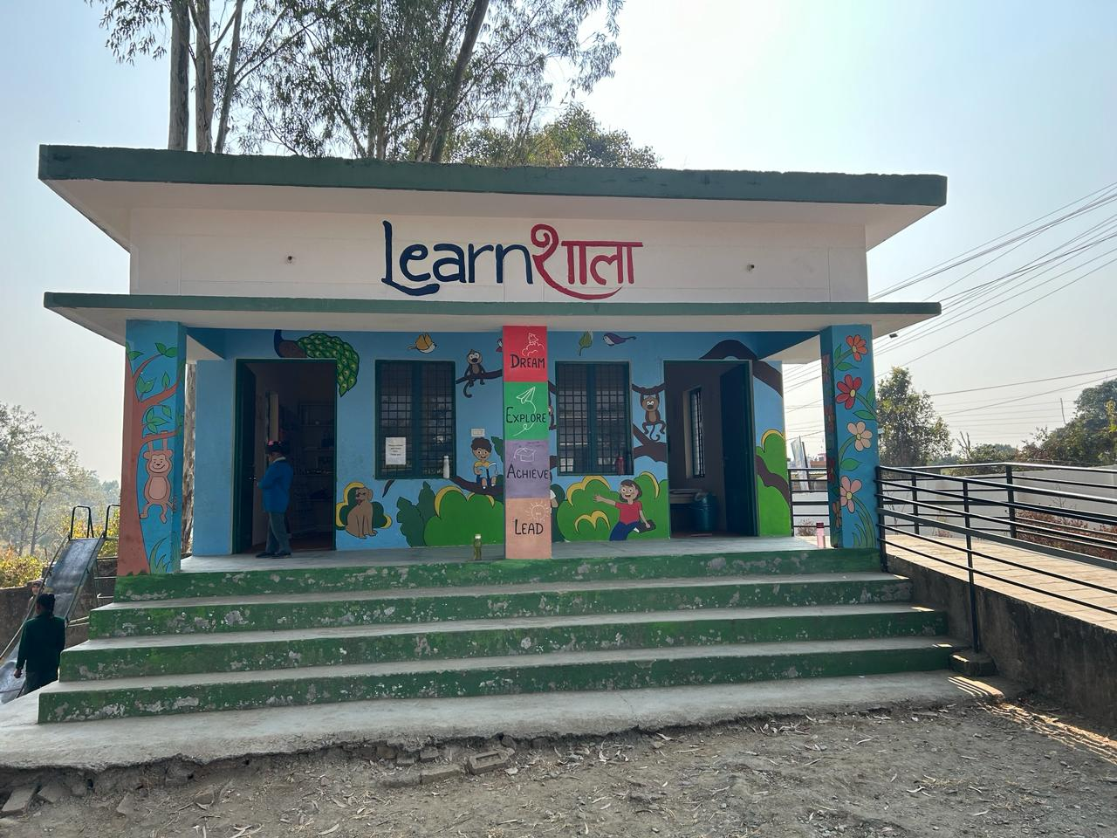
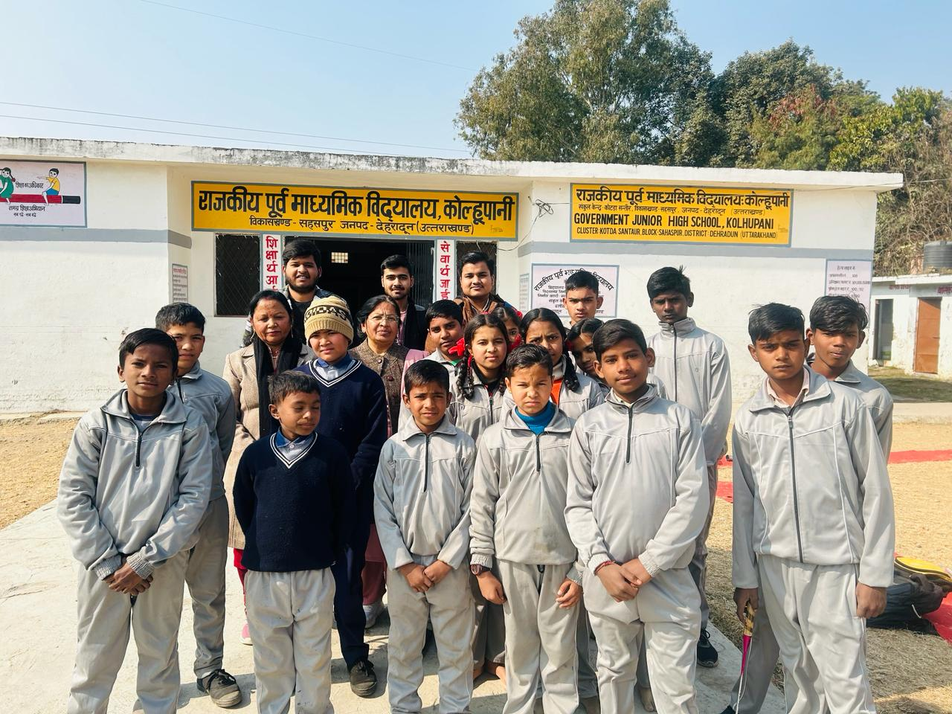
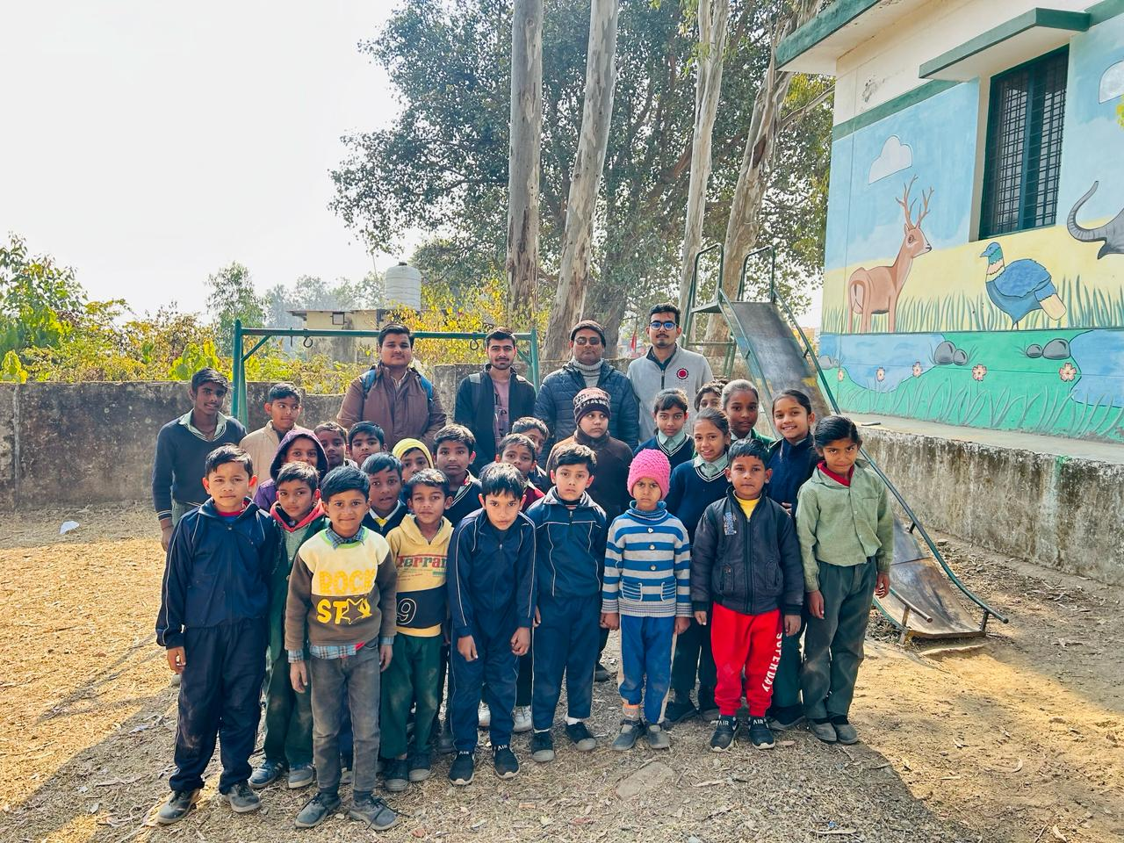
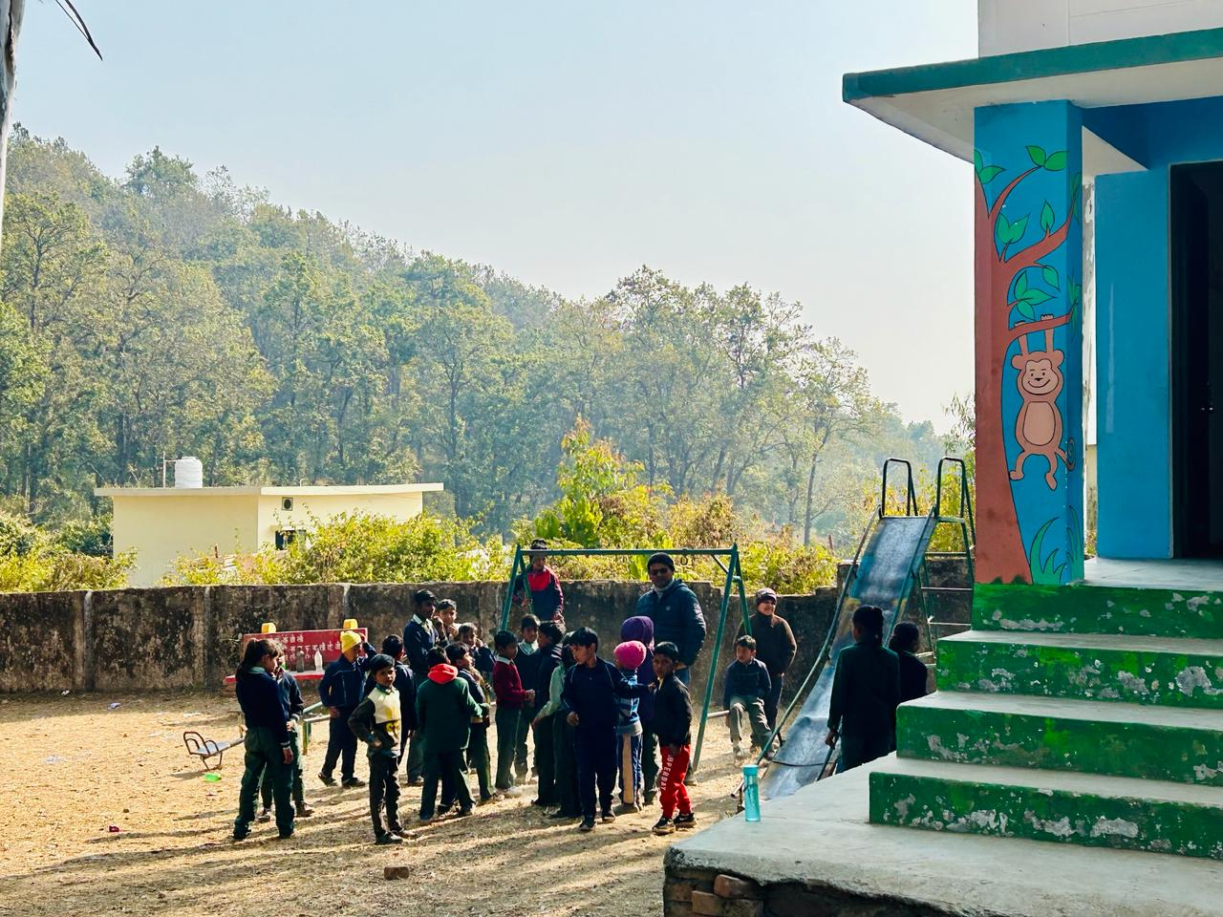
11. Survey: -

Slide 14
Thank You

